Slide 1
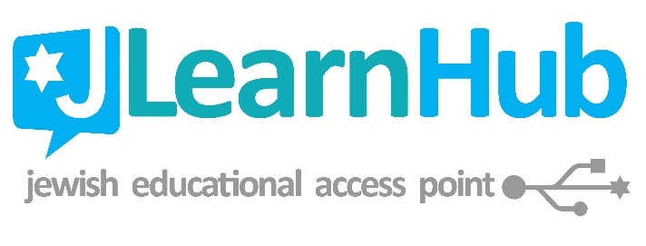
“Guess what, Mom?
I’m teaching myself Hebrew!”
Self-Paced Learning in Hebrew School
Rae Antonoff Portnoy, MAJE
rae@antonoff.net
rae@jlearnhub.com
www.JLearnHub.com

Slide 2



Elements of a Successful
Self-Paced Learning Program
Self-Paced ≠ Unguided
Learning materials with self-evident instructions
Answer key for students to check their own work OR enough staff to check each student’s work at least once per session
Source for auditory input
Opportunities for assessment & feedback
Clear progression path for moving from lesson to lesson

Slide 3
Who has tried a self-paced Hebrew learning program?
Which program(s)/material(s)?
What strengths did the program have in your experience?
What were the greatest challenges?

Slide 4
Why Try Self-Paced Learning in Hebrew School?
Logistical/Practical Reasons
  Irregular attendance
  Push for greater flexibility in Jewish educational options
  Potential for greater differentiation by students’ learning strengths and challenges
Theoretical/Ideological Reasons
  Fosters lifelong independent study skills
  Students take ownership of their learning
  Can disrupt the “graduation requirement” approach to pre-B’nai Mitzvah learning

Slide 5
The Theory
Flexibility
Differentiation
Foster natural curiosity
Culture change

Slide 6
The Practice
Setup: Classroom vs.
“Beit Midrash” style
Staffing
Assessment and positive reinforcement
Transition time
Materials & Technology

Slide 7
What’s Out There
DECODING
Phonetic Hebrew Decoding – by Sara Rosen
Shalom Hebrew – Behrman House
Let’s Learn Hebrew Side By Side - JECC
Hebrew Step-By-Step – by Rae Antonoff / JLearnHub
PRAYER HEBREW
Mitkadem – Behrman House (originally URJ)
Self-Guided Hineni - Behrman House
Torah Aura / ShalomLearning
Beit Midrash Prayer Guides – by Rae Antonoff / JLearnHub

Slide 8

Decoding
שַׂבָּת

Slide 9
Phonetic Hebrew Decoding by Sara Rosen
http://hebrewreading.com/portfolio-items/a-look-inside-book-1/
Packet 3
Pros:
  New app on the market
  Broken down into very small steps
  Great for younger learners
  Introduces all letters with “AH” vowels before introducing any other vowels
  Award pages at the end of each packet
  Uses transliteration liberally
Cons:
  Uses transliteration liberally
  Illustrations on the juvenile side
  Letter progression is less than ideal for some students

Slide 10
Shalom Hebrew | Behrman House
iPad app: Free download on the iOS App Store, but requires an OLC account/login
Pros:
  Immediate auditory input with Israeli + American accent options (note: initial default = Israeli)
  Solid letter progression
  Audio recordings/uploads
  Matching, Soundalike, & Writing activities for reinforcement directly in the app
Cons:
  iOS only
  Interface still buggy, especially the handwriting activities
  Accessibility concerns:
    Activity instructions not written/only verbal
    Correct-answer feedback too auditorily complicated
    Input for writing activities is finicky/frustrating at best, may be thoroughly inaccessible to learners with fine-motor disabilities
  Forced play-through (can’t skip lessons for review or learners not starting from scratch)

Slide 11
Let’s Learn Hebrew Side by Side (JECC)
http://letslearnhebrew.org/index.html
Pros:
  Designed with Digital Natives in mind
  Sound-to-Print
  Geared toward older students (5-7th grade)
  Can purchase individual or group subscriptions
  Shows multiple fonts
Cons:
  Need active internet access for first half of each lesson
  Geared toward older students (5-7th grade)

Slide 12
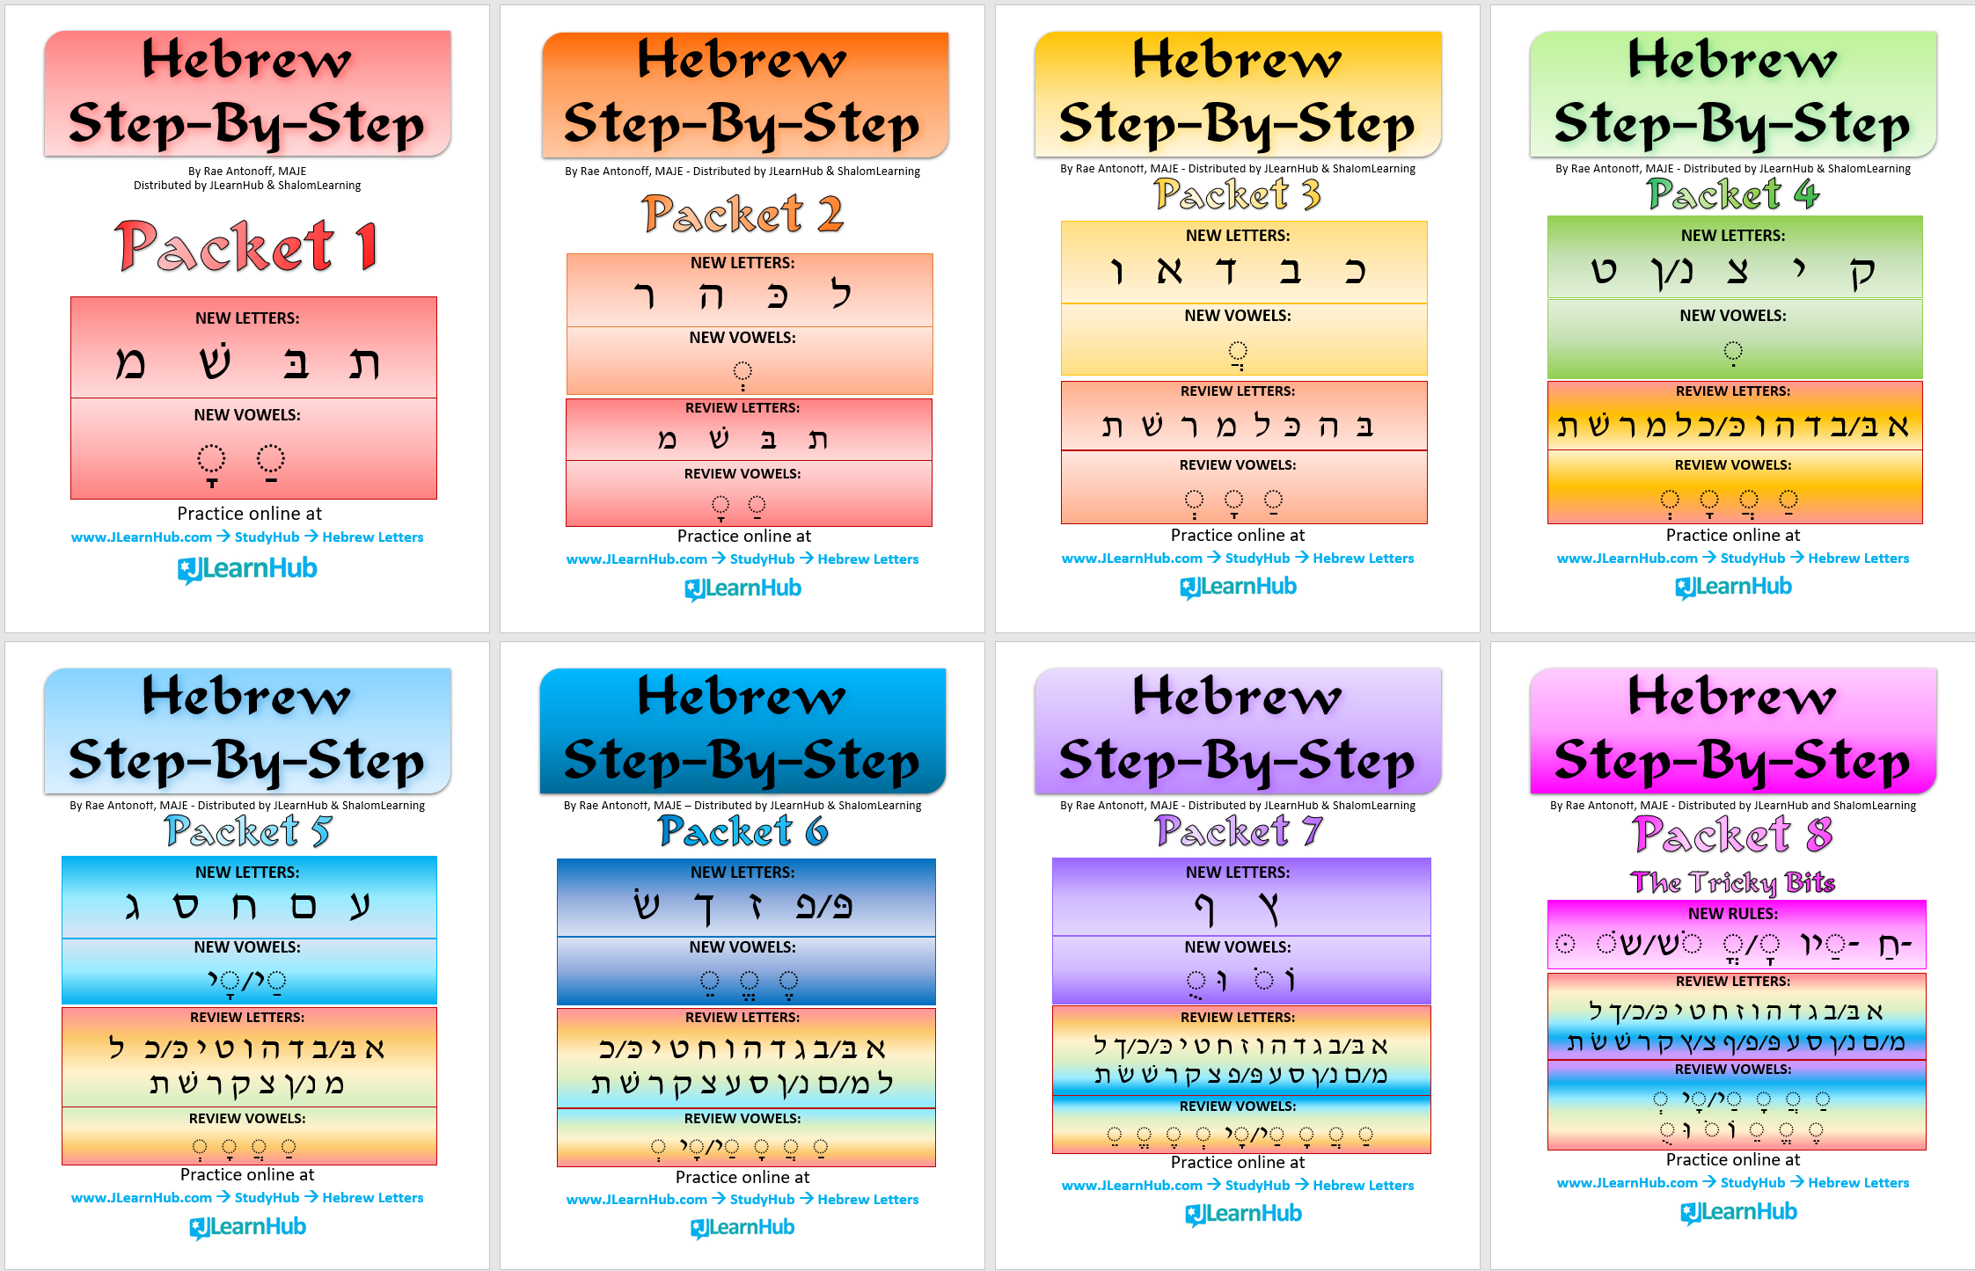
HSBS: PDF Packets & PowerPoints
1/2/3

Slide 13
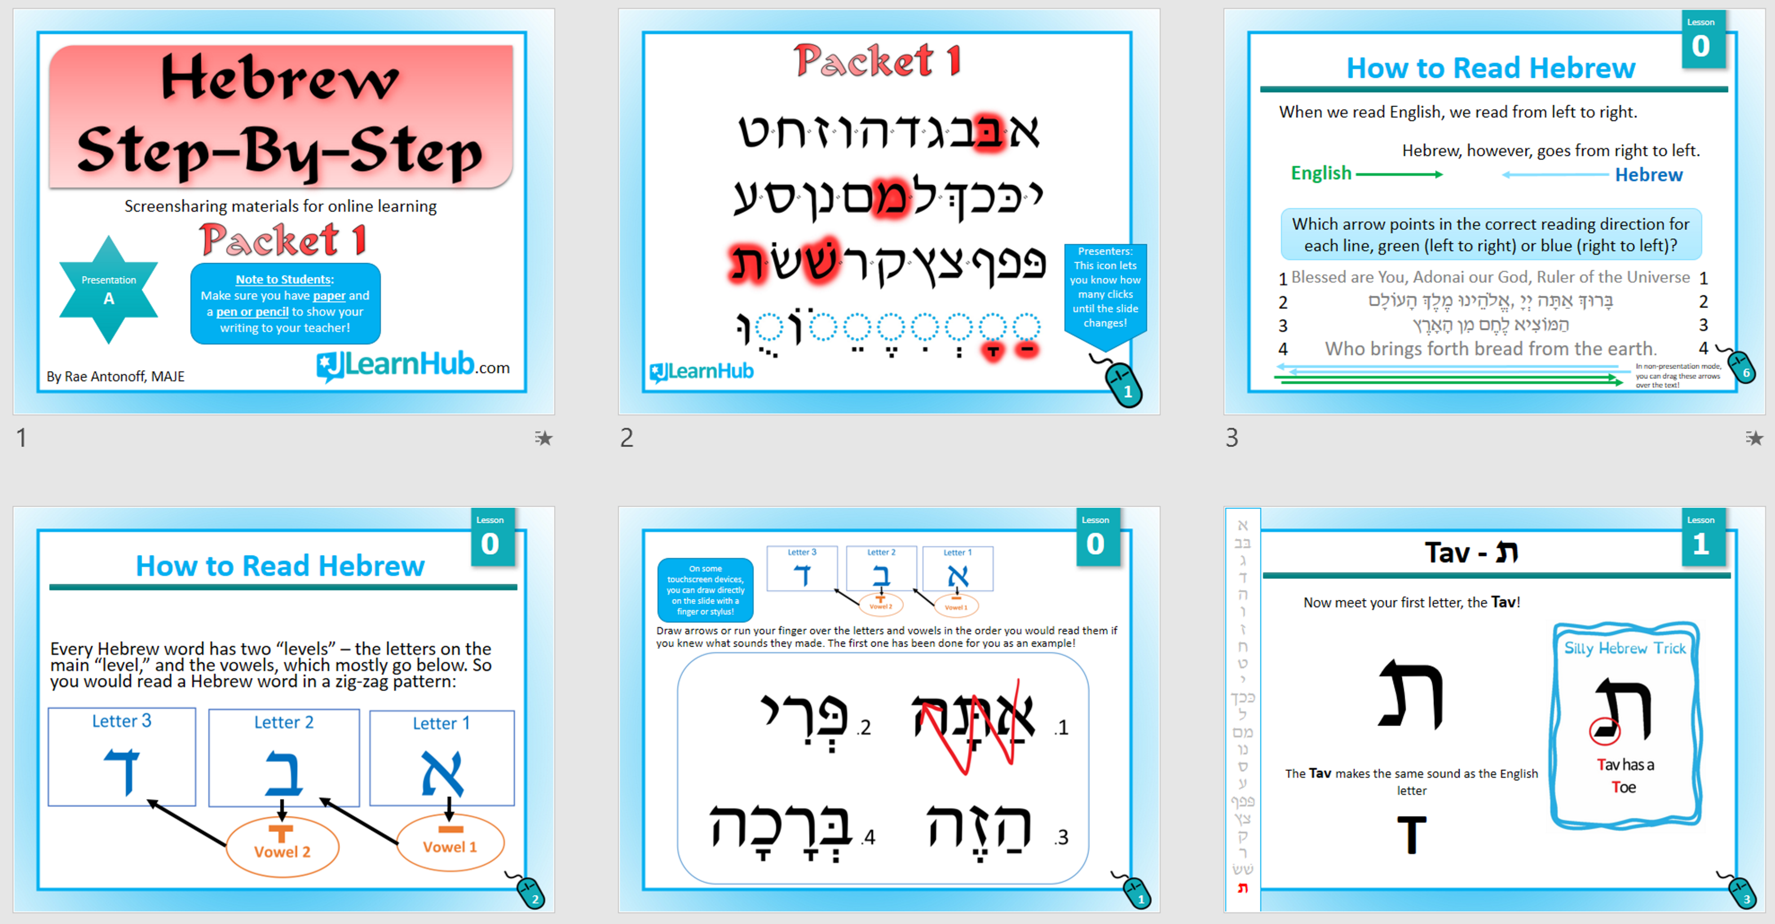
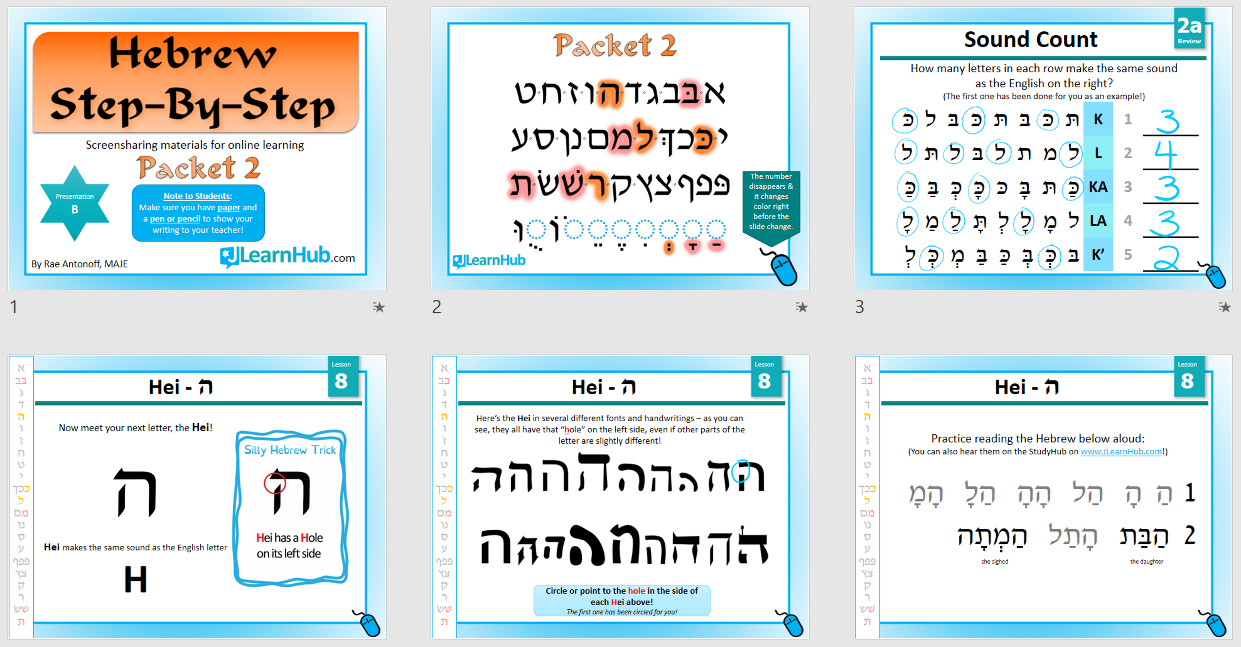
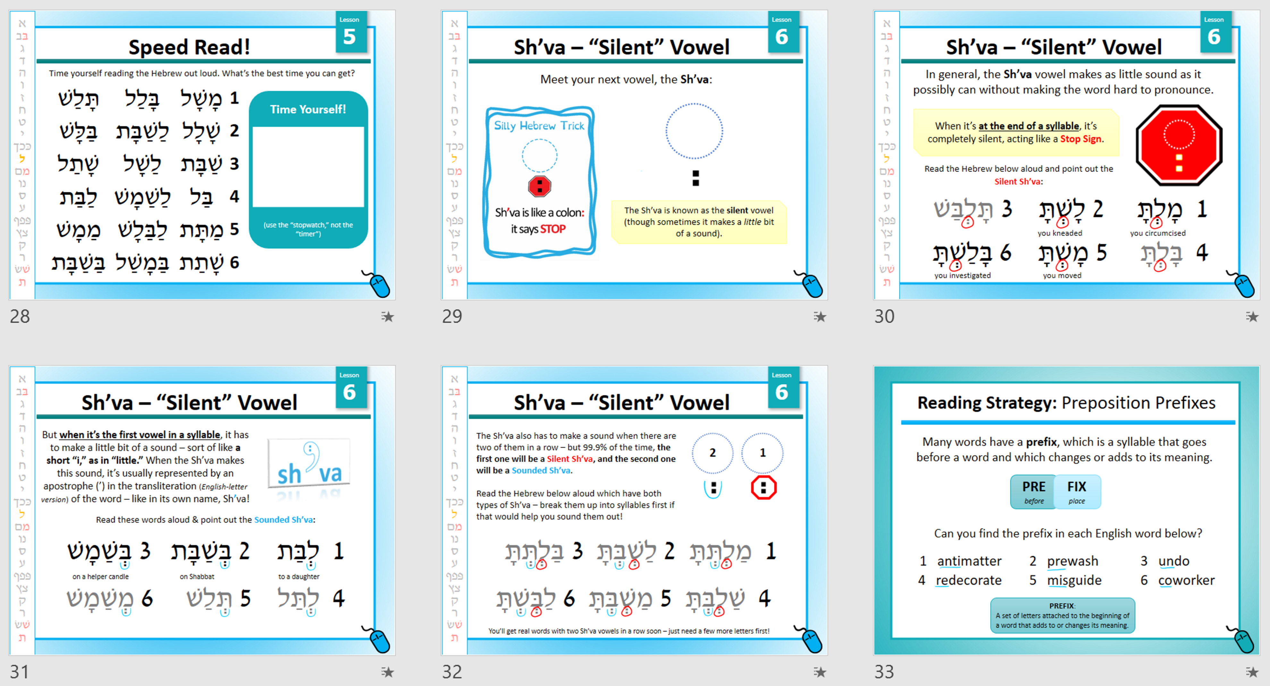
HSBS: PDF Packets & PowerPoints
1a/1b/2a/2b

Slide 14
Hebrew Step-By-Step by Rae Antonoff for JLearnHub
Pros
  Makes extensive use of silly mnemonics
  Exposes students to multiple fonts
  Introduces small but relevant grammatical concepts throughout (e.g. prefix vs. suffix, basic prepositions, etc.)
  Award page at the end of each packet
  Can print out just some pages for Review or Boot-Camp situations
  So far, student feedback indicates it’s easy and enjoyable to navigate on one’s own
  Colorful! (But also still works great when printed in B&W.)
  Coordinated soundboards & review games now available on JiTap, JLearnHub.com, and the ShalomLearning LMS
  ShalomLearning LMS offers individual student progress tracking, written & audio recording assignment uploads, badges, & more
Cons
  Colorful (expensive to print nicely)
  Coordinating video, audio, & web games still in development
  Some of the exercises do not work for all students (though they’re also skippable)

Slide 15


T’fillah Literacy
בָּרוּךְ אַתָּה יְיָ
וְאָהַבְתָּ אֵת יְיָ
עָלֵינוּ לְשַׁבֵּחַ

Slide 16
Mitkadem
Pros
  Robust answer keys
  Sleek production quality
  Each Ramah (level) has a To-Do List page at the front
  Able to pick and choose types of activities to require
  Ramot (levels) are in a clear progression, which educators can choose to reorder (i.e. do Ramah 4, then 7, then 3…)
  Emphasizes meaning-making over recitation
Cons
  Not at all conducive to whole-class work
  Amount of material can be overwhelming – many supplemental schools remove some sections
  Implementation often very rocky at first
  Emphasizes meaning-making over recitation

Slide 17
Self-Guided Hineni
Pros
  Group-pace and self-pace flexible: excellent for students who attend class in person sporadically but want to keep up with a class that otherwise progresses as a group
  Goes along with Click-and-Pray on the Behrman House website for auditory input
  Balanced emphasis on recitation and meaning-making
Cons
  For Level 1, Click-and-Pray reads the entire line when clicked rather than individual words; some prayers it will finish the whole prayer rather than stopping at the end of the line.
  One speed: may go too fast for some students
  Reading only for most prayers – to learn tunes, need to supplement

Slide 18
Torah Aura T’fillot / ShalomLearning
Pros
  Group-pace and self-pace flexible: works for students who attend class in person sporadically but want to keep up with a class that otherwise progresses as a group
  Full LMS with brief thematic introduction, prayer audio, and student recording uploads
  Lots of prayers available, many with Reform and Traditional options where applicable
  Primary emphasis on recitation over meaning-making
Cons
  Primary emphasis on recitation over meaning-making
  Works best with regular tech/device access for each student
  Typography/graphic/design quality is mediocre, may be challenging for students with visual processing disabilities (e.g. dyslexia)

Slide 19
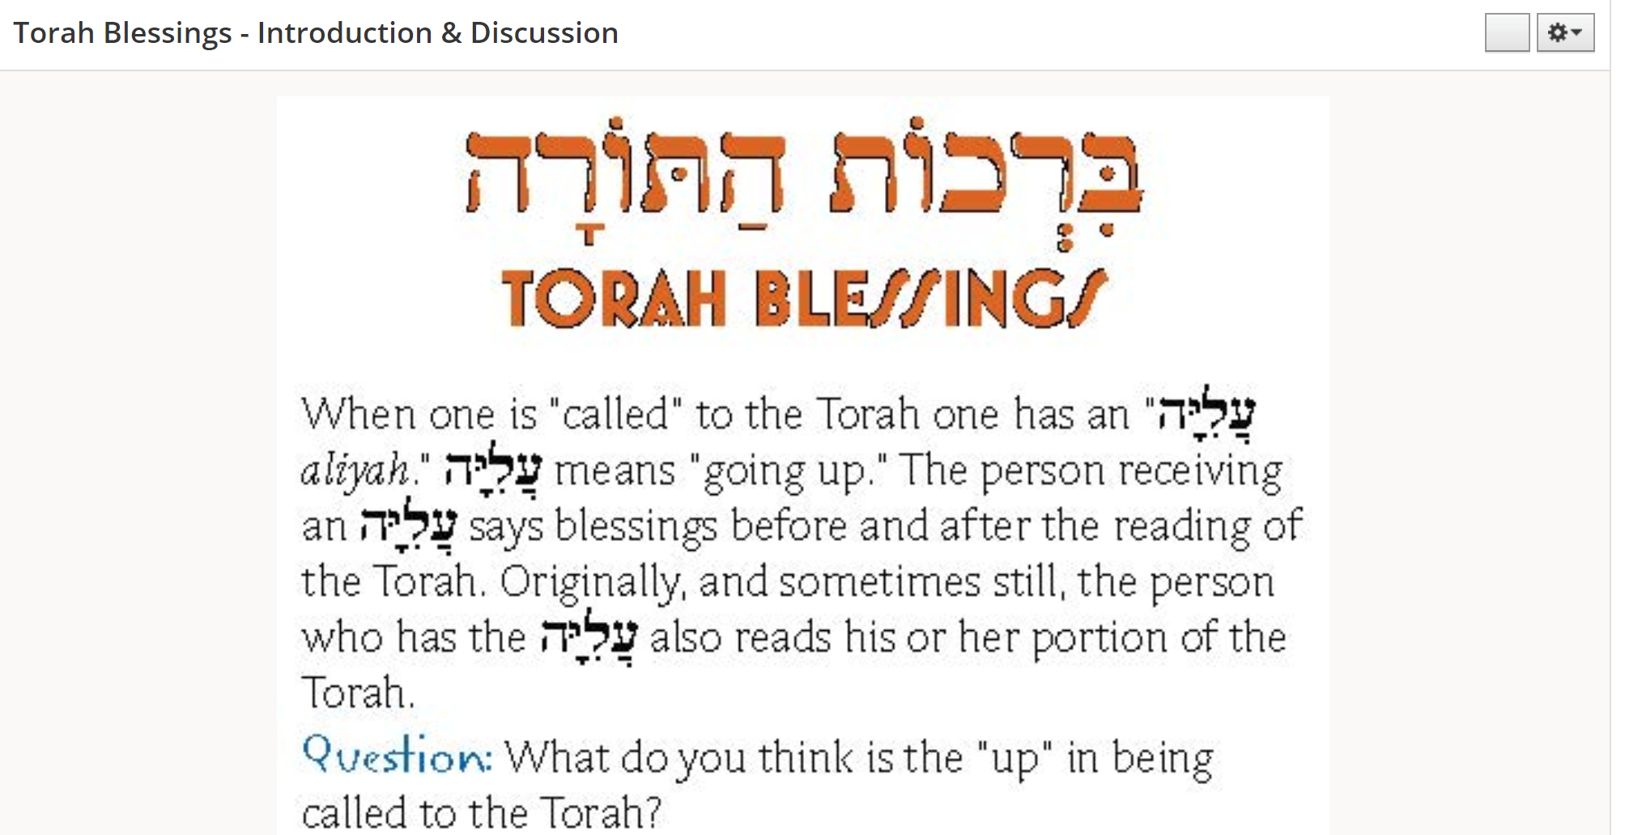
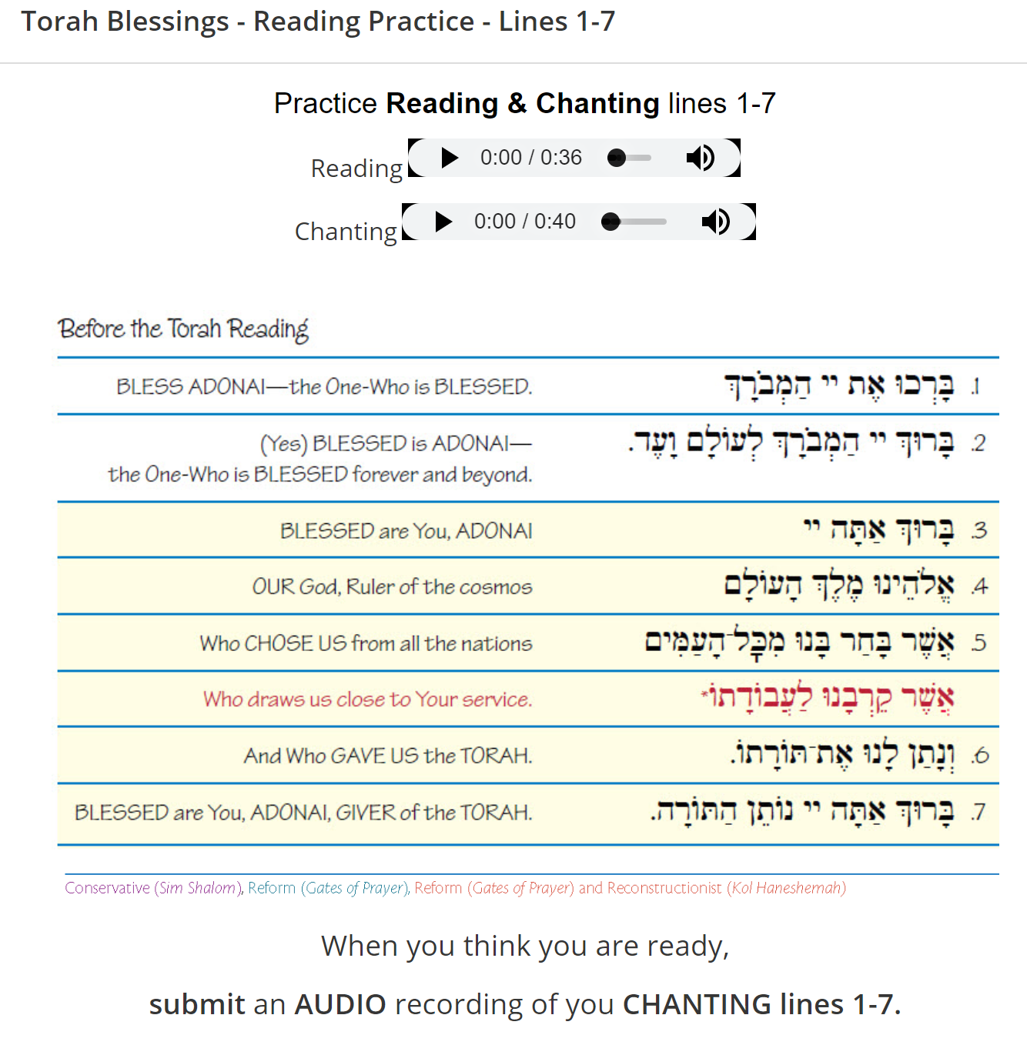
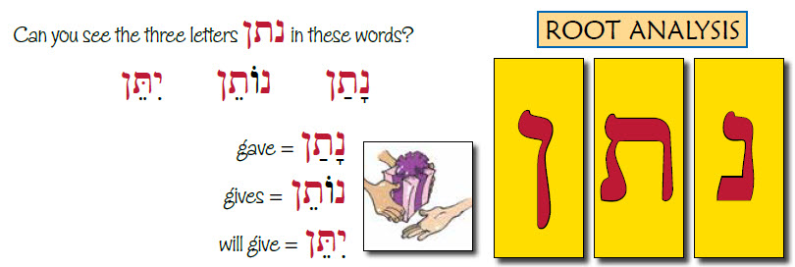

Slide 20
Beit Midrash Prayer Guides
Potential Prayers: https://docs.google.com/spreadsheets/d/1vCrf14zRptWazJ5pHIh4299bL1nxSVq5fEKItI3LIIE/edit#gid=0
Guide S01 – Bar’chu
Guide S04 – Sh’ma
Pros
  Blended learning – expects students to use their “21st Century Skills,” e.g. advanced search parameters and filtering search results for source quality
  Coordinated audio and video – read and sung, many in multiple speeds, on YouTube and an HTML5 site (accessible on every device, including mobile) : www.JLearnHub.com → StudyHub → Prayers
  Intended to be a modular / “Interchangeable Parts” program: choose the prayers to cover and the order in which to provide them to students (or follow the recommended order)
Cons
  Challenging transition to learning how to learn independently & in chevruta
  Still in development… but more prayers are coming!

Slide 21
Challenges & Opportunities of Self-Paced
Hebrew Programs

Slide 22

www.JLearnHub.com
www.facebook.com/JLearnHub
Rae Antonoff Portnoy, MAJE
Founder & Director
rae@antonoff.net
rae@jlearnhub.com

